Slide 1





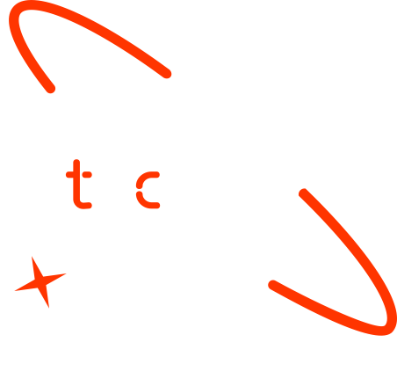

A new generation
of tech specialists

Slide 2

Forecasting Disease Outbreaks Using Integrated Mobility and Health Data
Han D D Htet,
Kyaw Zin Htet,
Aung Ko Min,
Naing Lin

Slide 3
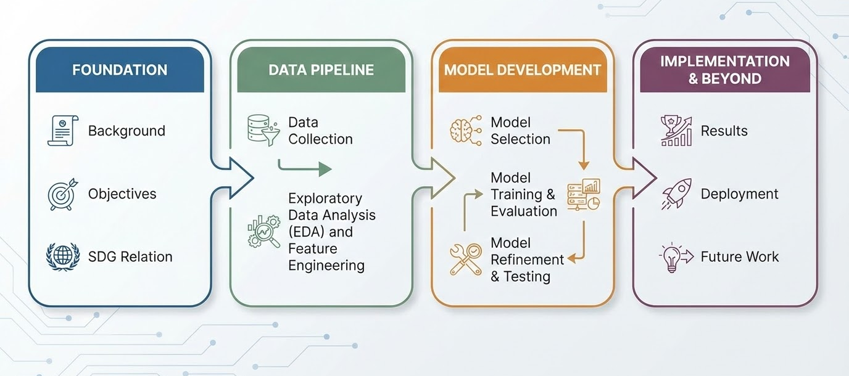
Outline
Concept note and implementation plan:​
Background​
Objectives​
SDG Relation​
Data​:
Data Collection​
Exploratory Data Analysis (EDA) and Feature Engineering​
Model​:
Model Selection
Model Training & Evaluation
Model Refinement & Testing​
Results​:
Deployment​:
Future Work:

Slide 4
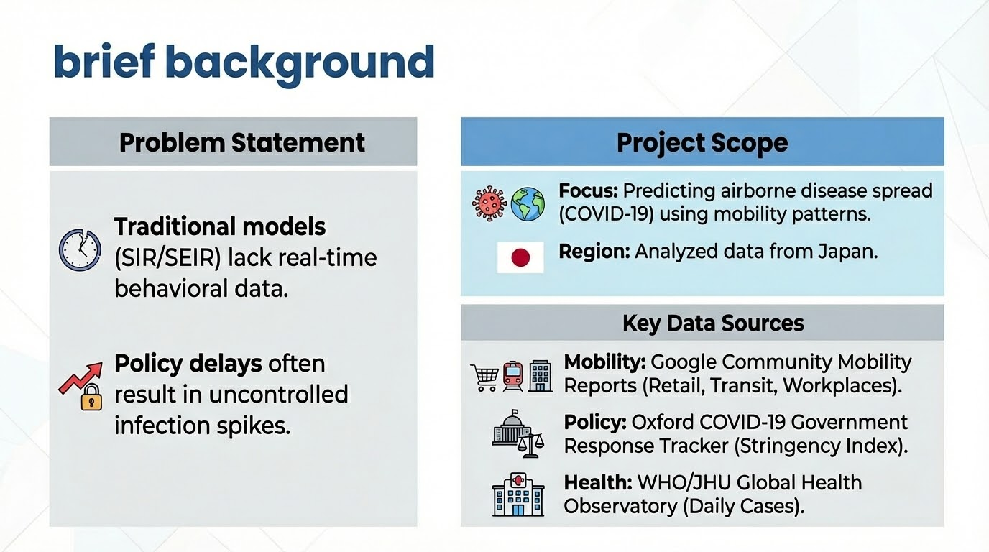
Background
Problem Statement
Traditional models (SIR/SEIR) lack real-time behavioral data.
Policy delays often result in uncontrolled infection spikes.
Project Scope
Focus: Predicting airborne disease spread (COVID-19) using mobility patterns.
Region: Analyzed data from Japan,
Key Data Sources
Mobility: Google Community Mobility Reports (Retail, Transit, Workplaces).
Policy: Oxford COVID-19 Government Response Tracker (Stringency Index).
Health: WHO/JHU Global Health Observatory (Daily Cases).
brief background​

Slide 5
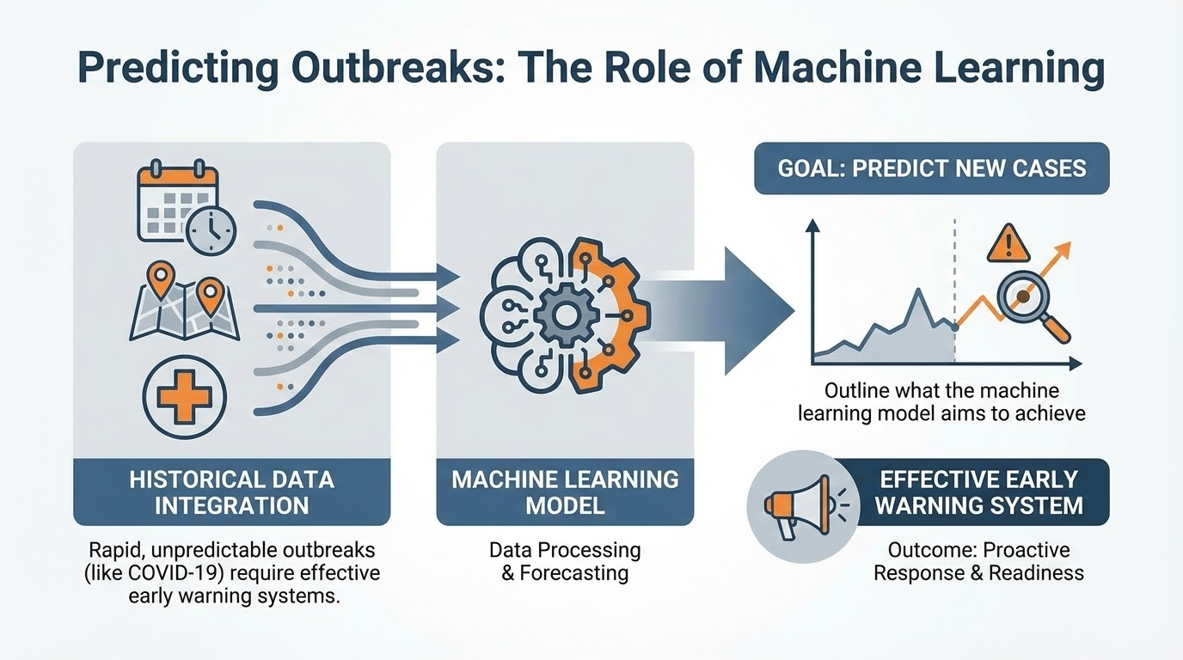
Objectives
Rapid, unpredictable outbreaks (like COVID-19) require effective early warning systems.
Goal: Predict new cases using historical data integration
Outline what the machine learning model aims to achieve

Slide 6
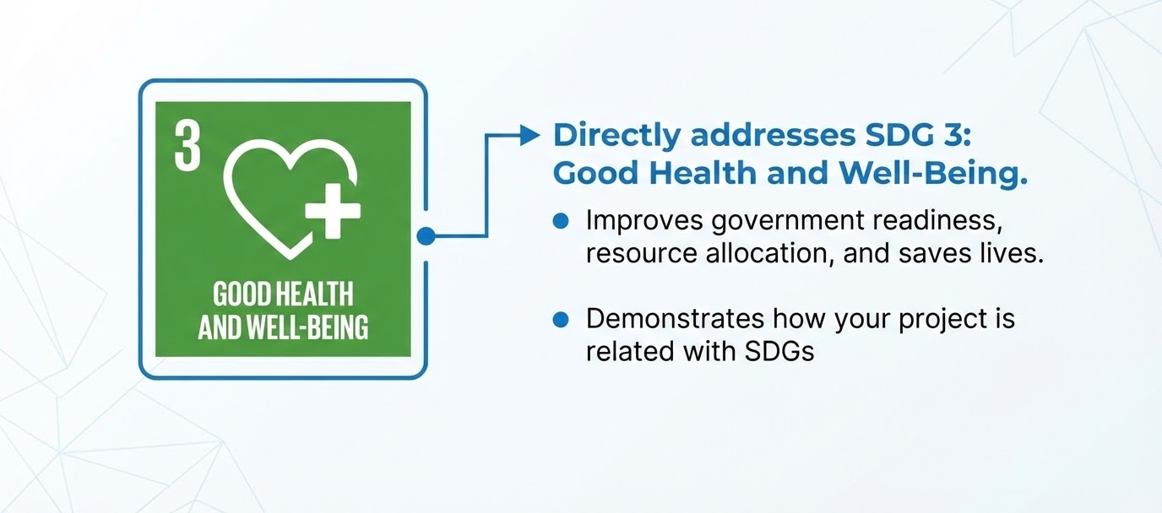
SDG Relation
Directly addresses SDG 3: Good Health and Well-Being.
Improves government readiness, resource allocation, and saves lives.de how your project is related with SDGs

Slide 7
Data

Slide 8
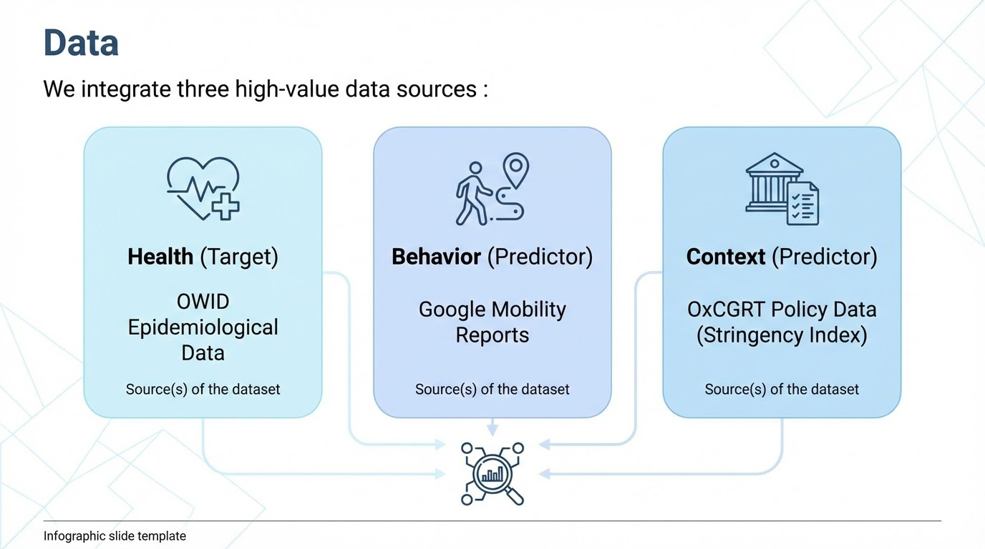
Data

Slide 9
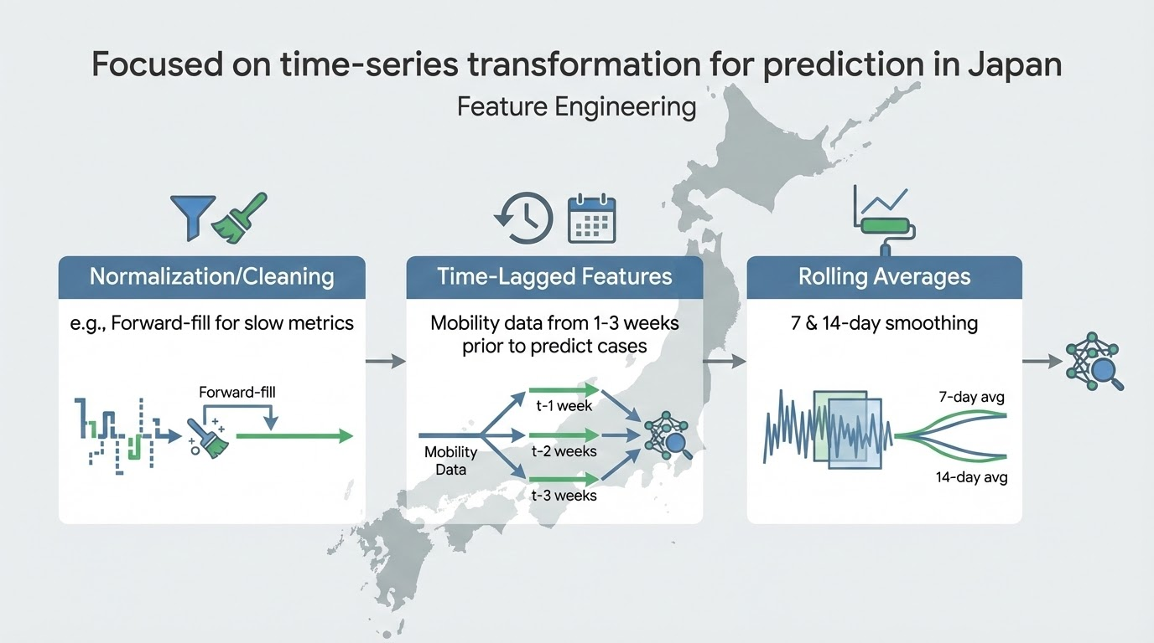
Feature Engineering
Focused on time-series transformation for prediction in Japan :
Normalization/Cleaning (e.g., Forward-fill for slow metrics).
Time-Lagged Features (Mobility data from 1-3 weeks prior to predict cases).
Rolling Averages (7 & 14-day smoothing).

Slide 10
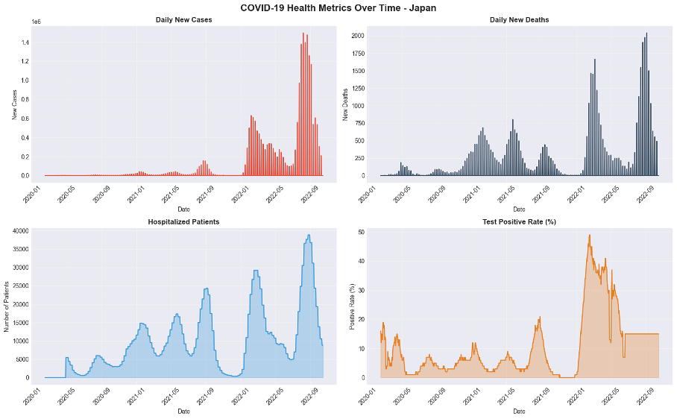
EDA
Time-series trends: Multi-panel views for new_cases, new_deaths, hosp_patients, positive_rate show waves and policy/behavioral shifts.

Slide 11
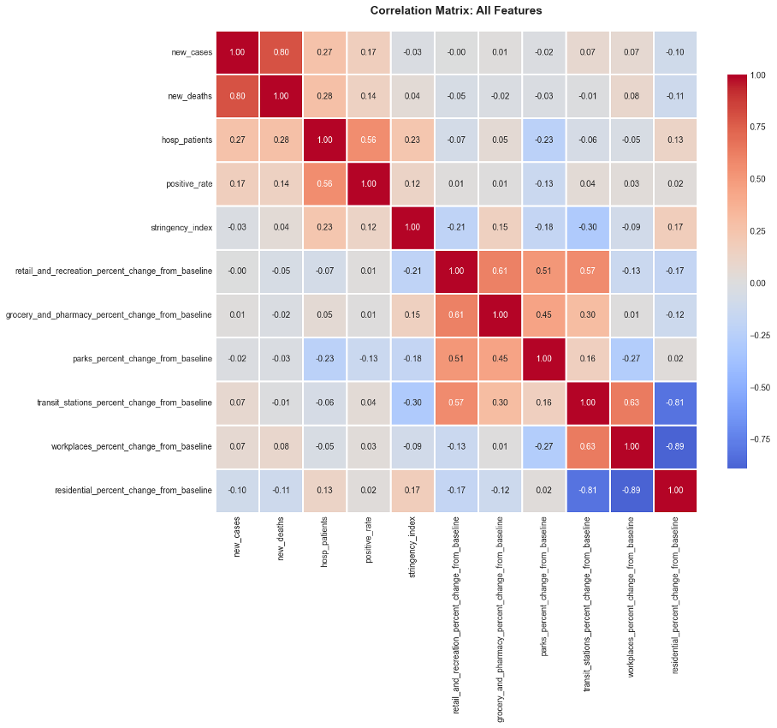
Correlations: Full correlation matrix; top correlations with new_cases and positive_rate highlighted.
● Correlations: Full correlation matrix; top correlations with new_cases and positive_rate highlighted.

Slide 12
Model

Slide 13
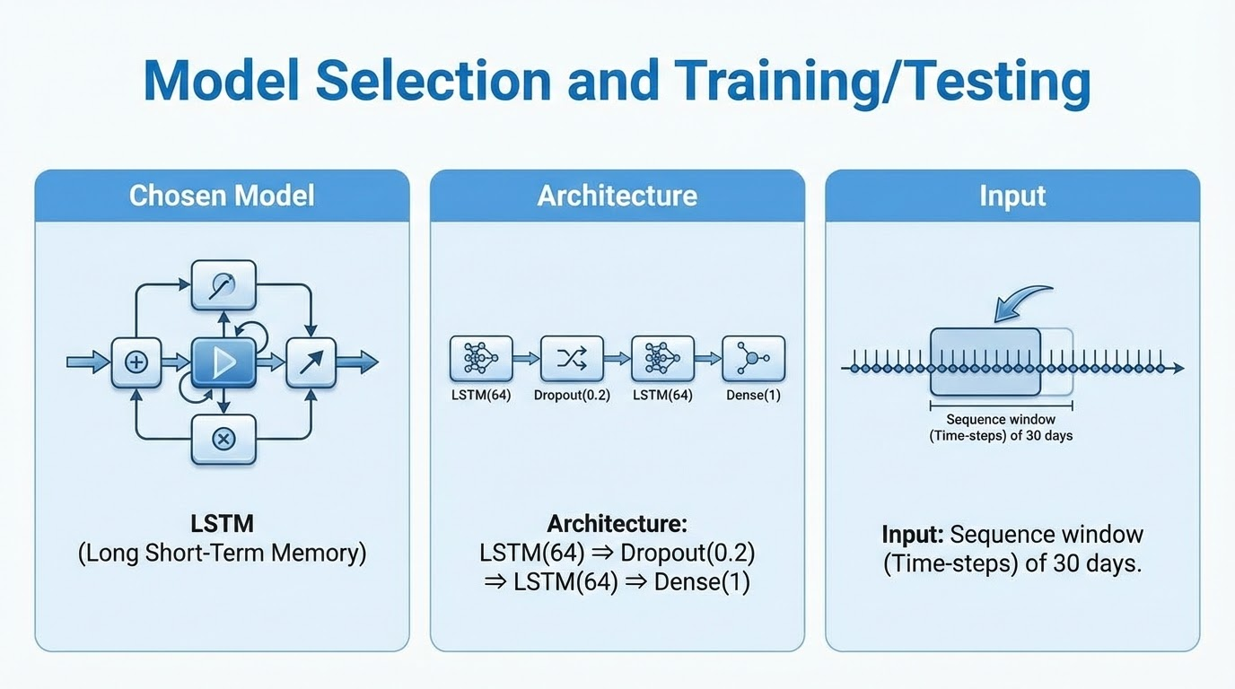
Model Selection
Chosen Model: LSTM (Long Short-Term Memory).
Architecture: LSTM(64) ⇒ Dropout(0.2) ⇒ LSTM(64) ⇒ Dense(1).
Input: Sequence window (Time-steps) of 30 days.

Slide 14
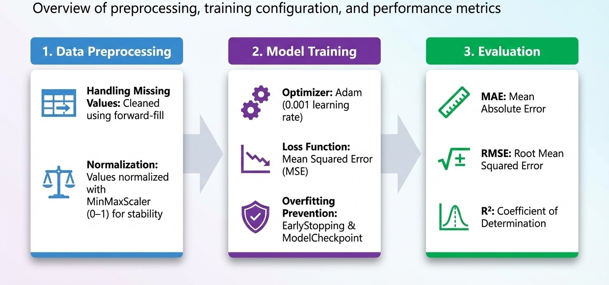
Model Training & Evaluation
LSTM (Long Short-Term Memory) chosen due to strong performance in time-series forecasting
Data cleaned using forward-fill to handle missing values
Values normalized with MinMaxScaler (0–1) for stable training
Optimizer: Adam (0.001 learning rate)
Loss function: Mean Squared Error (MSE)
EarlyStopping and ModelCheckpoint used to prevent overfitting
Evaluated using:
MAE (Mean Absolute Error)
RMSE (Root Mean Squared Error)
R² (Coefficient of Determination)

Slide 15
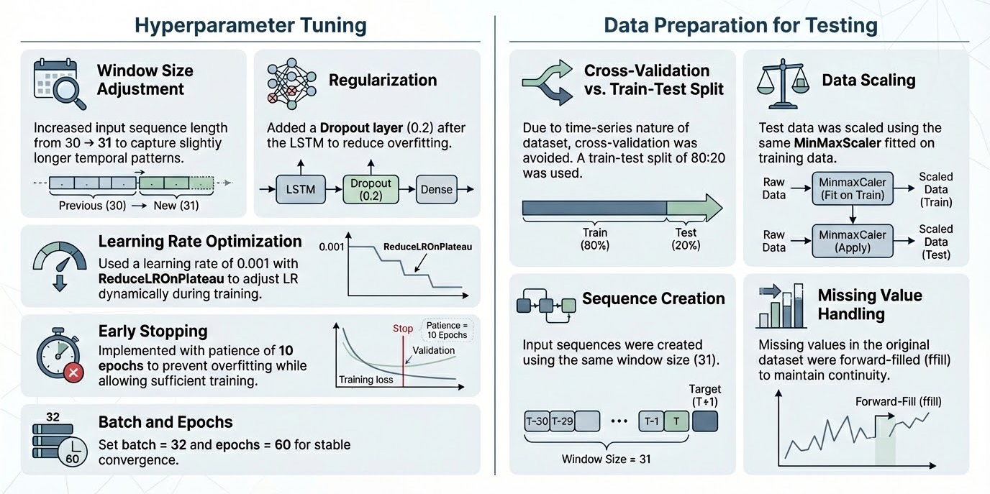
Model Refinement & Testing
Hyperparameter Tuning:
Window Size Adjustment: Increased input sequence length from 30 → 31 to capture slightly longer temporal patterns.
Regularization: Added a Dropout layer (0.2) after the LSTM to reduce overfitting.
Learning Rate Optimization: Used a learning rate of 0.001 with ReduceLROnPlateau to adjust LR dynamically during training.
Early Stopping: Implemented with patience of 10 epochs to prevent overfitting while allowing sufficient training.
Batch and Epochs: Set batch = 32 and epochs = 60 for stable convergence.
Due to time-series nature of dataset, cross-validation was avoided.
A train-test split of 80:20 was used. Test data was scaled using the same MinMaxScaler fitted on training data.
Input sequences were created using the same window size (31).
Missing values in the original dataset were forward-filled (ffill) to maintain continuity.

Slide 16
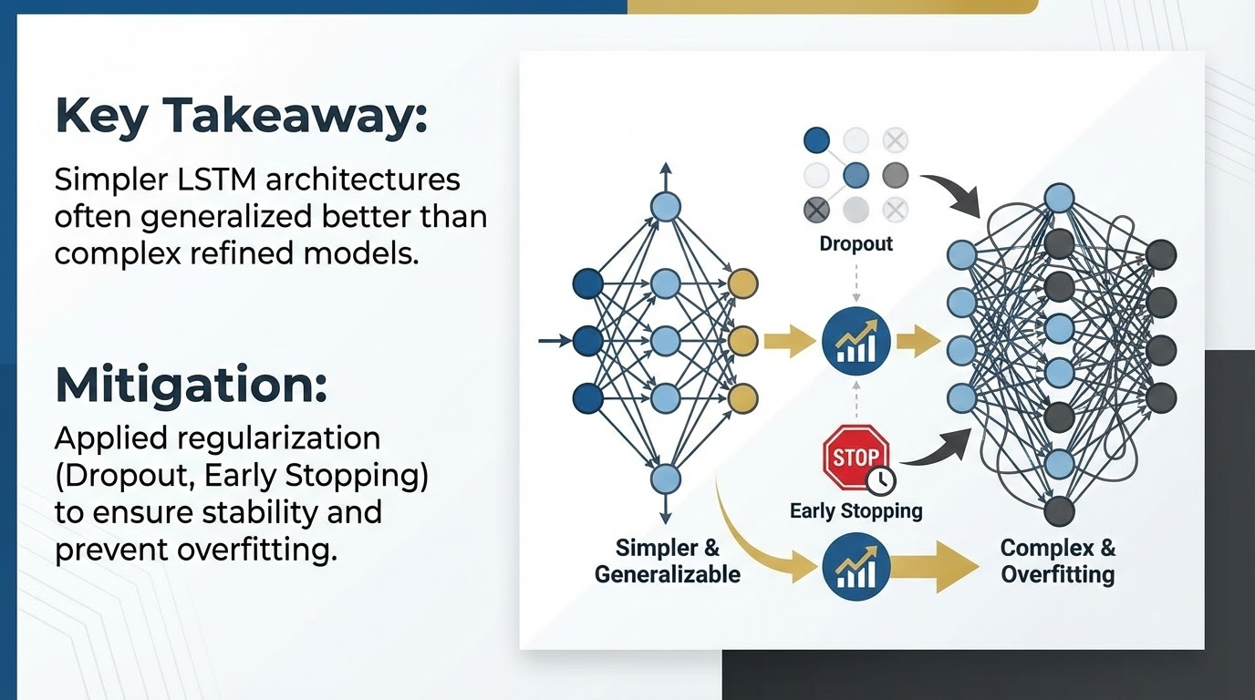
Model Development Lessons
Key Takeaway:
Simpler LSTM architectures often generalized better than complex refined models.
Mitigation:
Applied regularization (Dropout, Early Stopping) to ensure stability and prevent overfitting

Slide 17
Result

Slide 18
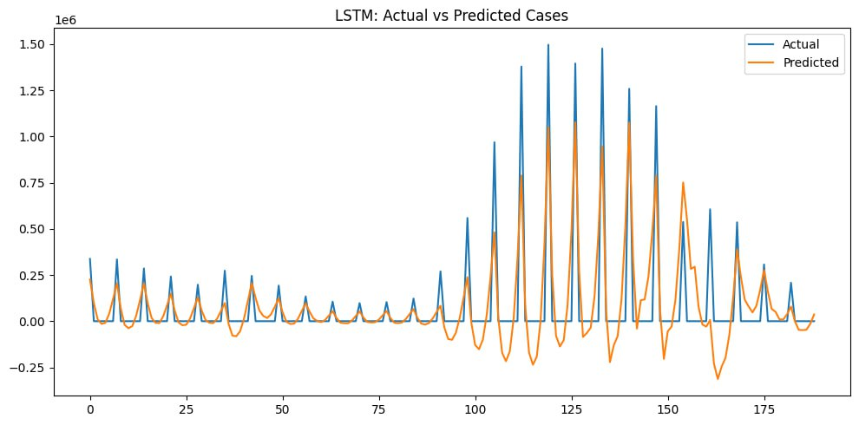
Evaluation Results
Performance Metrics of Trained Model (LSTM):
MAE: 15468.38
RMSE: 21345.14
R²: 0.9071
Insight:
Captures trends well but struggles with sudden spikes.
Model captures general outbreak patterns.
Struggles with sharp fluctuations and extreme peaks
Results highlight the need for improved preprocessing, feature engineering, or model refinement to better handle outbreak volatility

Slide 19
Deployment

Slide 20
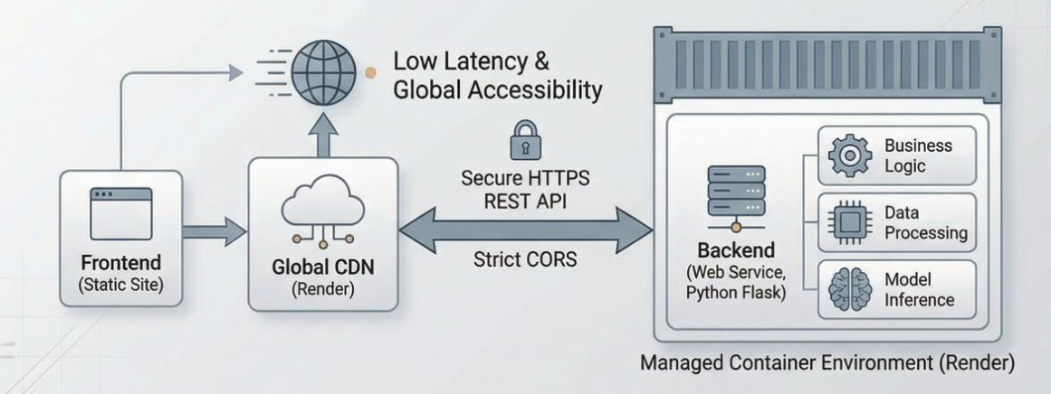
Deployment
Frontend, Backend & Communication serialization, serving, and API integration​

Slide 21
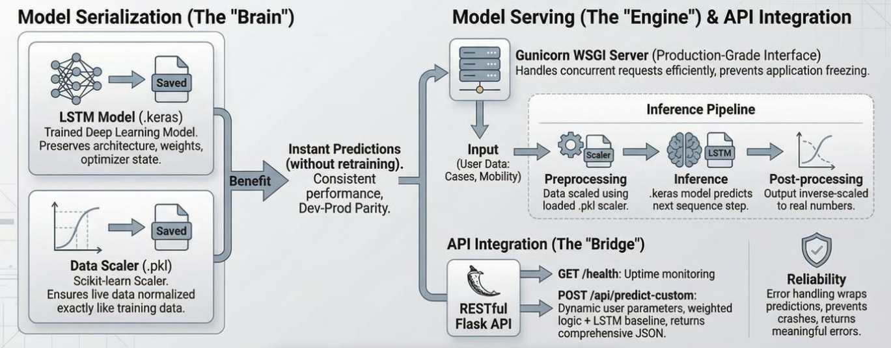
Model Serialization, Servering & API Integration

Slide 22
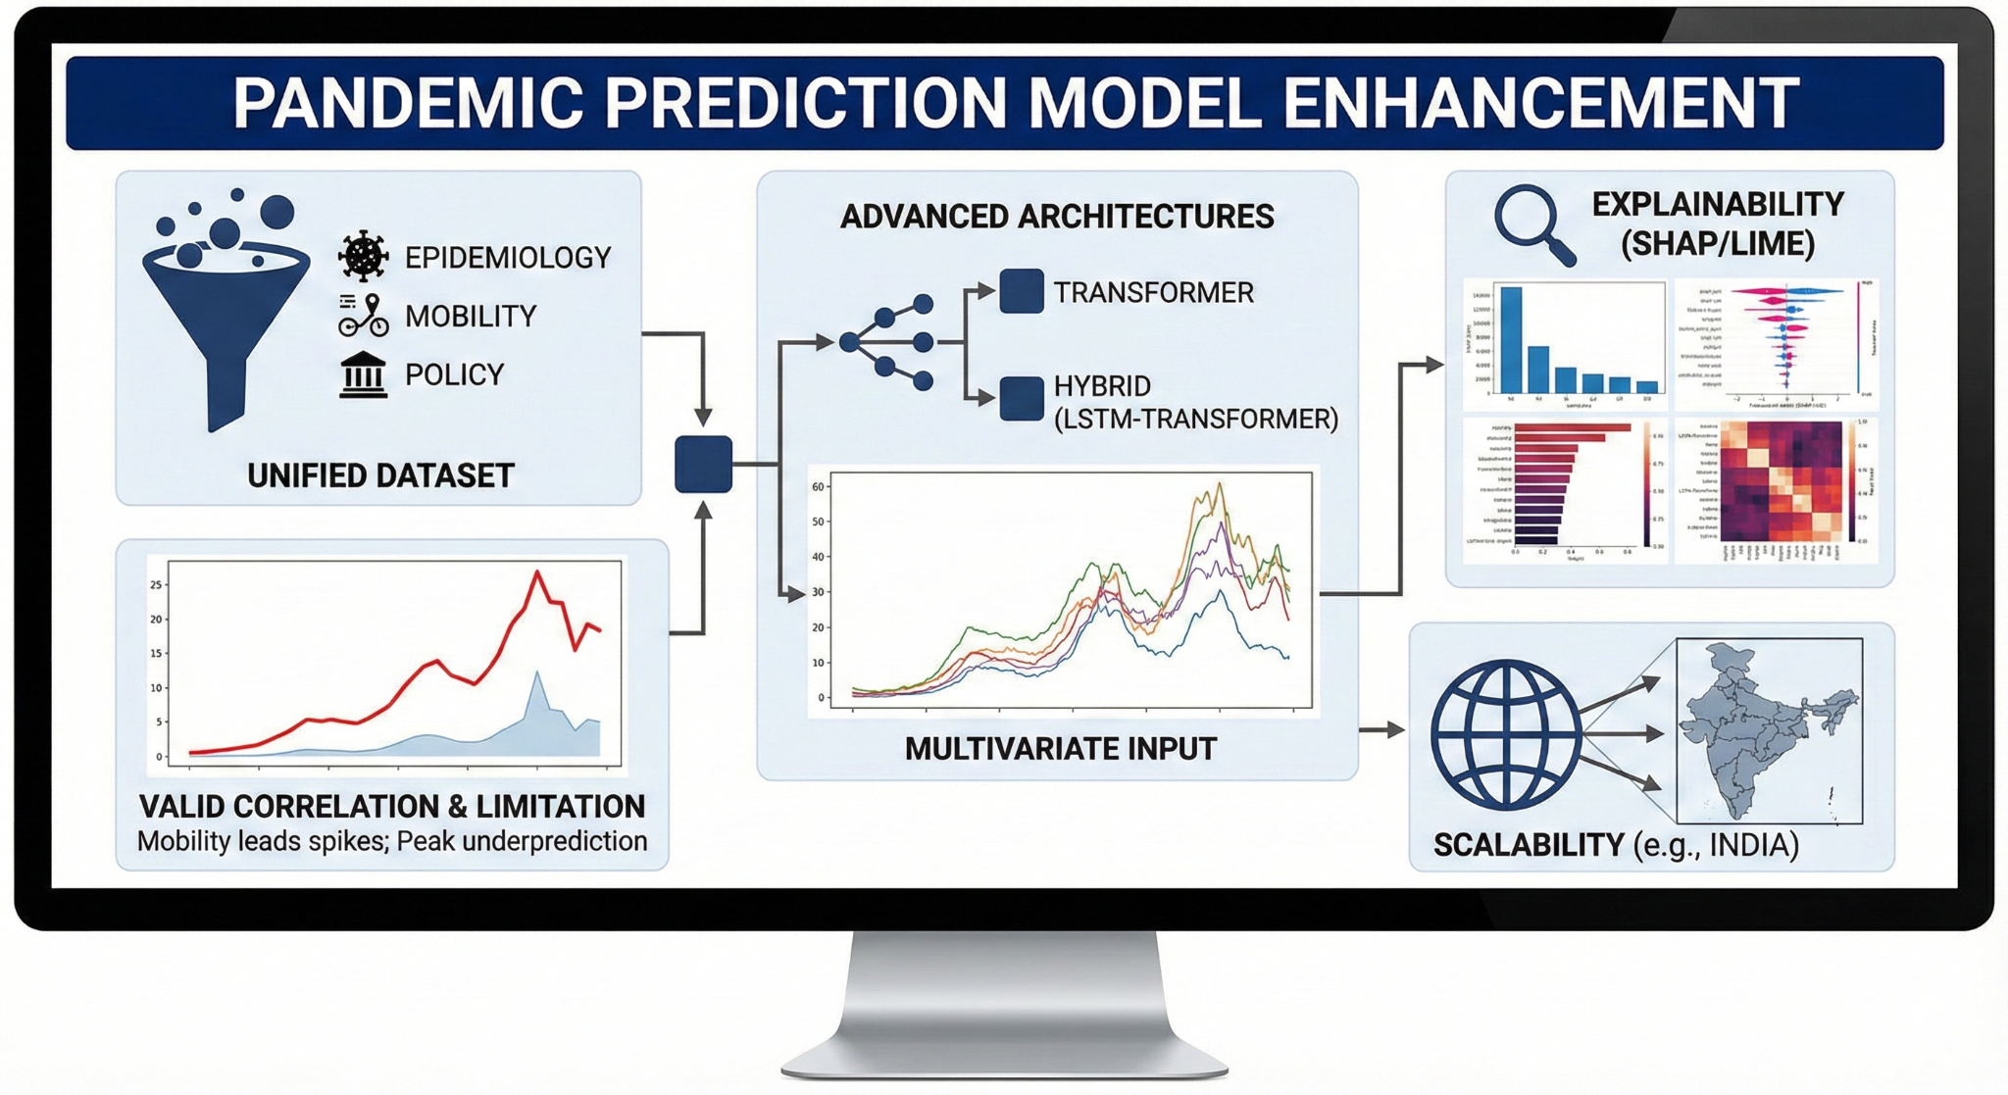
Conclusion and Futurework

Slide 23

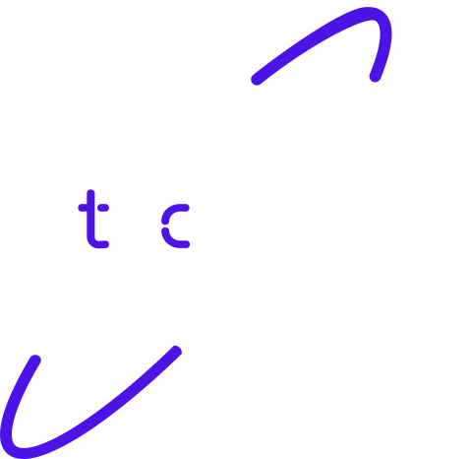
Thank you!

